Slide 1

Services Weekly Project Review 7 May 2025

Slide 2
Agenda
Review Management Summary Level for all active projects (chart)
Review One Pagers, Project & Deployment Timelines and Back to Green plans for Red and Amber Status Projects
Note One pager to include split on Use Cases Customer/Product
Key Milestone Dates should be included
Transition to Support Dates to be included
Adhoc review of Projects in Green Status - one pagers, project and deployment timelines
Review Tracker table of transition to support Dates
Update Master Sheet for overall project status
Actions from last week

Slide 3
Project Health(Customer Wise)– India Team
RED | AMBER | GREEN
CHT(core9) | Nestle(core9) | HPCL
 | TRL | McD(CPlus - POC)
 | JIO BP CNG | HUL(CPlus - POC)
 | JIO BP SOLAR | Reliance(CPlus - POC)
 |  | JIO BP RMS
 |  | JIO BP Warehouse
 |  | JIO BP EV
 |  | UPL
 |  | L&T
 |  | WoolWorths
 |  | Britannia
 |  | Xerox
 |  | Heineken
 |  | Datema
 |  | Onitio
 |  | Novo Nordisk

Slide 4
Customer Health– India Team
RED | AMBER | GREEN
CHT(core9) | Nestle(core9) | HPCL
 | TRL | McD(CPlus)
 | JIO BP CNG | HUL(CPlus)
 | JIO BP SOLAR Britannia | Reliance(CPlus)
 |  | JIO BP RMS
 |  | JIO BP Warehouse
 |  | JIO BP EV
 |  | UPL
 |  | L&T
 |  | WoolWorths
 |  | Britannia
 |  | Xerox
 |  | Heineken
 |  | Datema
 |  | Onitio
 |  | Novo Nordisk

Slide 5
Deployment Plan
Sr No | Projects | Status | Project Scope | Owner | Q1 | Q2 | Q3 | Q4 | Notes
1 | JIOBP AFS | 🔴 | POC | Nayanika / Ananthan
2 | CHT | 🔴 |  | Nayanika
3 | Nestle | 🟠 | 250 cameras additional to 4 Sites existing | Nayanika
4 | TRL | 🟠 | Adding 150 additional cameras - currently 25 cameras supported | Nayanika
5 | JIOBP NRO | 🟠 | 40 Sites | Nayanika / Ananthan |  |  |  |  | Moved to support in Q1
6 | JIOBP Solar | 🟠 | 15 Sites | Nayanika / Ananthan |  |  |  |  | Currently in support , there will be phase 2 deployment coming in Q2
7 | Britannia | 🟢 | 20 Cameras (1 site) in support/ Additional 49 sites are in TBD | Pavan
8 | L&T | 🟢 | 1000 Cameras - Sites? | Geetha / Nithin
9 | HPCL | 🟢 | Retail – 6246 / 3800 Sites . Locations – 3400 / 82 Sites | Nithin/ Geetha/ Pavan |  |  |  |  | Retail Phase 1- 200 sites moved to support Retail Phase 2 -467/600 sites moved to support. Locations-82 sites moved to support
10 | JIOBP CNG | 🟢 | 30 Sites | Nayanika / Ananthan |  |  |  |  | Moved to support , Levnovo – Issues in process

Slide 6
Deployment Plan
Sr No | Projects | Status | Project Scope | Owner | Q1 | Q2 | Q3 | Q4 | Notes
11 | JIOBP EV | 🟢 | 28 Sites | Nayanika / Ananthan |  |  |  |  | Dependent on client
12 | JIOBP Warehouse | 🟢 | 2 Sites | Nayanika / Ananthan |  |  |  |  | In Support
13 | Reliance Digital - POC | 🟢 | 97 Cameras/5 Sites | Pavan
14 | MCD - POC | 🟢 | 24 cameras/2 sites | Pavan
15 | Onitio | 🟢 | Deployed at 2 sites | Prakhar
16 | Datema | 🟢 | Deployed at 2 sites | Prakhar
17 | UPL | 🟢 | 84 cameras | Nayanika / Ananthan
18 | Heineken | 🟢 | Deployed at 1 site | Prakhar
19 | Xerox | 🟢 | Deployed at 2 sites | Prakhar
20 | Novo Nordisk | 🟢 | Deployed at 1 site | Prakhar
21 | Woolworth | 🟢 | POC | Nithin
22 | HUL - POC | 🟢 | TBD | Pavan
23 | JIOBP Cleanliness -POC | 🟢 | POC | Geetha

Slide 7
Deployment Plan
Sr No | Projects | Status | Number of Cameras Number of sites | Owner | Year 2024 | Q1 2025 | Q2 2025 | Q3 2025 | Q4 2025 | Comment
23 | UPL | 🟢 | 84 cameras | Nayanika / Ananthan
24 | Heineken | 🟢 | Deployed at 1 site | Prakhar |  | In Support
25 | Xerox | 🟢 | Deployed at 2 sites | Prakhar |  | In Support
26 | Novo Nordisk | 🟢 | Deployed at 1 site | Prakhar |  | In Support

Slide 8
Red Project Update

Slide 9
Nestle - Pakistan
Project Status - 🔴 Customer health - 🟠 Hosting– On Avathon Cloud
Scope & Implementation Date (including Revenue)
Deployment of VAIA solution on 250 cameras across 4 sites.
Handover of the solution is planned on April 15th, 2025
Revenue- 800K
Total Use cases: 16
Customized Use cases: 7
Product Use cases: 9
This week’s Status to Plan
Pending from Nestle: The Shiftwise feature has been deployed to UAT, and Core9/Nestle is currently validating the changes. Once approved, the changes will be moved to production.
Bulk closing feature for alarms is deployed and released as per the plan on 24th April, 2025 currently in UAT
3. Regarding Sign-off: It was decided that Core9 and Nestle was supposed conduct tests from 28th. Based on the results, the solution was supposed be handed over to Nestle team for testing and sign off 30th April, 2025. Due to server shutdown, this activity was not possible.
4. We have documented the edge case scenario where the 3M use case might work and not work. Although the current model is working as expected.
.
Schedule for Next Week 1. To conduct tests on each camera against each use case.
2. Handover to support plan will be in place on 30th April, 2025. This plan might change due to server shutdown.
2.
Issues & Risks
The NVR timings are incorrect on most of the cameras. This issue has been logged with Nestle for investigation and resolution.
Malicious Activity seen on nestle servers last week, and the same issue is reported to Core9. Later, we had to deploy the solution on all the servers. Although, We have not heard any updates regarding the shutdown from core9/Nestle.

Slide 10
Back to Green Plan- Nestle
To conduct the tests on all cameras against each use case and get a sign off from Nestle/Core9 team.
To work closely with the team and solve issues during testing.
Pending from Nestle Team:
The camera view change occurs frequently in Nestle and they are reluctant to change the view to the original view. Due to this, the solution may or may not work as expected.
Pixelation issue in KBF site. Needs to be resolved asap by client.
The NVR timings are incorrect on most of the cameras. This issue has been logged with Nestle for investigation and resolution.

Slide 11
CHT – Pakistan
Project Status - 🔴 Customer health - 🟠 Cloud - Avathon Cloud
Scope & Implementation Date (including Revenue)
Reasons Leading to Project Pause:
The performance of the solution was not accepted by CHT team and thus the project was paused for couple of months.
Current Update: The customer has approved the solution for deployment across four sites. Revenue: NA Total Use cases : 25 Customized Use cases: 10 Product Use cases: 15
This week’s Status to Plan
Handover of the solution to Core9 for initial testing is scheduled on May 5th, and final handover to CHT shall be given on 12th May, 2025.
Issues & Risks
Schedule for Next Week
Testing shall be conducted by Core9 on 6 HO cameras starting from 5th May. Our Team shall be available to address any issues/concerns.

Slide 12
Back to Green Plan- CHT
We will hand over the solution to Core9 on April 5th, after which they will conduct testing and provide approval. Once we receive the approval, the status will move to green.

Slide 13
JIOBP AFS
Project Status - 🔴 Customer health - 🟠 Cloud
Scope & Implementation Date (including Revenue)
POC is under discussion. Yet to finalise the date. Pending from RBML
This week’s Status to Plan
Schedule for Next Week
Back to gree plan - Once Jiobp provides us with the POC, we can proceed. We are waiting for their response.
Issues & Risks

Slide 14
Amber Project Update

Slide 15
JIOBP CNG
Project Status - 🟠 Customer health - 🟠 Cloud – On Avathon Cloud
Scope & Implementation Date (including Revenue)
Total Number of Sites: 30 Cameras Per Site: 5 Deployed Sites: 28 Total Use cases : 18 (14 customised, 4 in product) Upcoming Sites: 30
Revenue: $100,719.31
ARR - $68,191.54 Services - $32527.77
This week’s Status to Plan
Jointly simulated and test the wait time and fuelling status.
The camera angle adjustment drill is currently underway across all sites to improve accuracy and optimize the feasibility of all use cases.
Deployed Trend Analysis, Summary report in dashboard.
Issues & Risks 1. 2 Sites (KRT005 & JHF021) have port issues. 2. The Lenovo devices that have been installed are not consistently reliable. 3. Most sites have poorly positioned camera angles.
4. Few sites have poor network, even with AirFiber or SIM routers.
Schedule for Next Week
Wait time monitoring and testing in other Sites.
Back to Green Plan - Once Lenovo provides us with a fix, we will implement it across all sites, and the project will be marked as green.

Slide 16
JIOBP Solar
Project Status - 🟠 Customer health - 🟠 Cloud – On Avathon Cloud
Scope & Implementation Date (including Revenue)
Total Number of Sites: 15 Cameras Per Site: 10
Deployed Sites: 15 ( 2 sites L3 completed ) Total Use cases : 13 (7 Customised, 6 in product) Upcoming Sites: 40
Revenue: $170,743.05
ARR - $6,783.46 Services - $32527.77 Hardware - $154,687.50
This week’s Status to Plan
Data collection and retraining
2. We shipped 5 Raspberry Pi devices to Homantico on the 28th and an additional 7 devices on the 29th. All 12 devices are expected to be live across the 12 sites by May 5th.
Issues & Risks
Schedule for Next Week 1. Hardware installation and deployment.
2. Back to Green Plan - Once the sites are set up by May 5th, we can proceed with the deployment and move the project to green.

Slide 17
TRL
Project Status - 🟠 Customer health - 🟢 Cloud – On Prem Cloud
Scope & Implementation Date (including Revenue) Scope:
Expecting to run the solution on 150 cameras. Current Status: The solution is currently running on 25 cameras having 7 use cases.
Product Use case: 5
Customised Use case: 2
T
Renewal Update: The client has confirmed they will proceed with the renewal by the 15th of May, 2025.
This week’s Status to Plan
Follow up on the renewal plan with the client.
Issues & Risks
Schedule for Next Week Back to Green Plan - The client has confirmed they will proceed with the renewal by May 15th, 2025. Once we receive this confirmation, the project will move to green.
2.

Slide 18
L & T
Project Status -🟢 Customer health - 🟢 Hosting–On Prem ( L&T Cloud )
Scope & Implementation Date (including Revenue)
Deployment of VAIA at 1000 cameras
Implementation date – Jul 25
Arr Revenue- ( $115,664)
Total Usecases – 24 Available in product – 15
Custome use case - 8
This week’s Status to Plan
43 cameras Deployment is completed.
Mapping use cases against existing cameras.
Demo session completed for the user.
Schedule for Next Week
1.Planning to complete the deployment of–40 more cameras
2.Making changes in dashboard as per the customer requirement.
3.Awaiting for customer to provide details of usecase mapping against camera-wise .
4. The rollout plan has already been finalized and shared with L&T. We are currently awaiting their approval
Issues & Risks
They are 8 usecases which are not ready , under discussion with product team , meanwhile we have asked customer to provide simulation videos and more data for model training.
Dependencies is on customer to provide clarification on usecases hence we have setup call on Friday with customer and Prod team

Slide 19
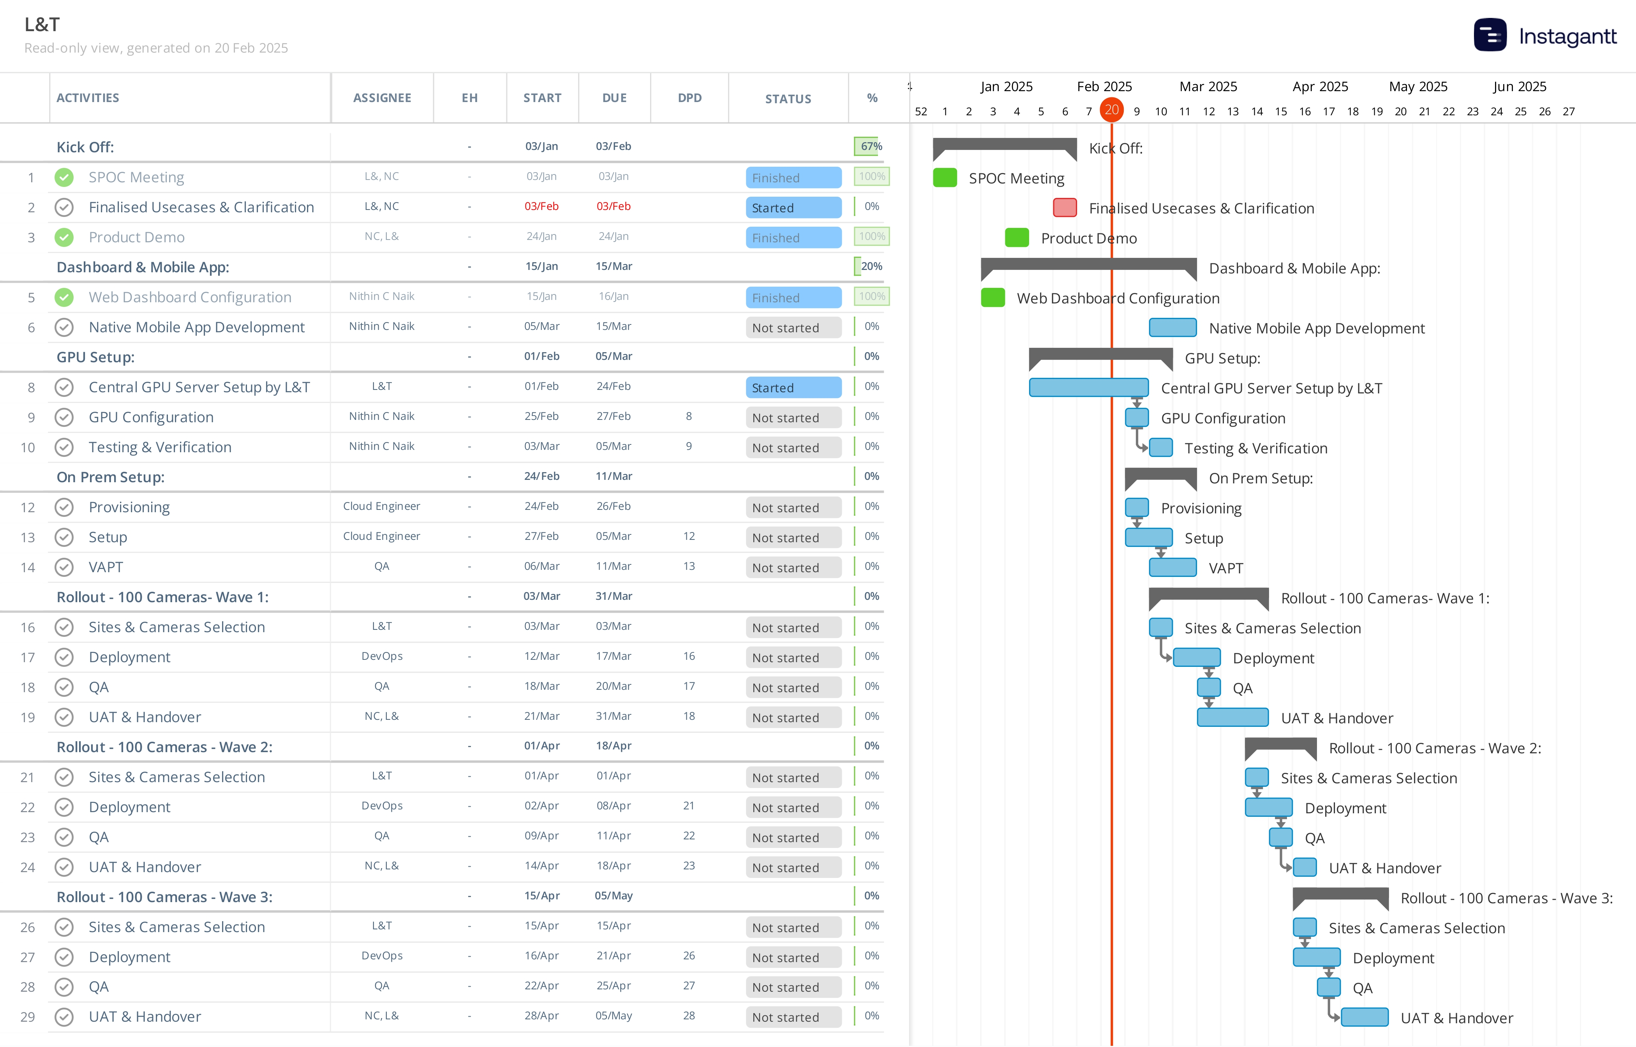
L&T Project Plan

Slide 20
Green Project Update

Slide 21
Britannia
Project Status - 🟢 Customer health - 🟢 Hosting– On prem
Scope & Implementation Date (including Revenue)
Deployment of VAIA at 50 sites
Implementation date – 18/02/2025
Revenue – $ 111,046
Total Usecases – 22 Available in product – 21
Custome usecase - 1
This week’s Status to Plan Tested all of use cases, and all alerts are generated.
Issues & Risks
Schedule for Next Week
Reviewing the changes implemented on dashboard and Feedback on the alerts generated session with Britannia planned in this week
Discussion happened with customer on rollout plan, Waiting on customer to respond on the same

Slide 22
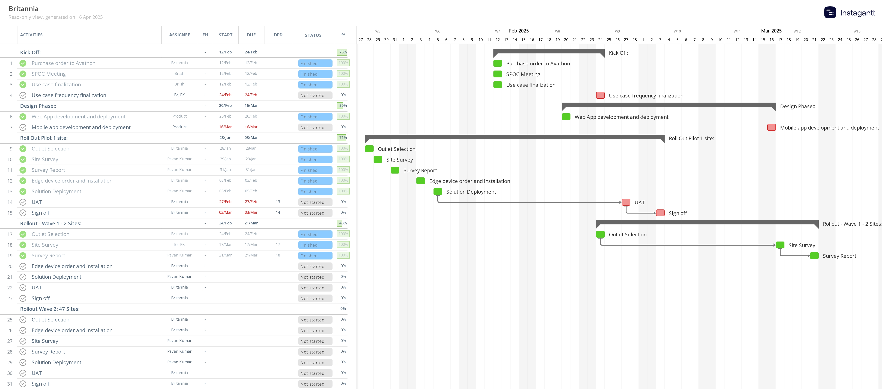
Project Plan Britannia

Slide 23
Woolworths ( POC )
Project Status - 🟢 Customer health - 🟢 Cloud -Avathon Cloud
Scope & Implementation Date (including Revenue)
Deployment of VAIA at 2 POC Sites
POC Completion Date- May 30
Revenue – 3.6 mil ARR , 3.6 mil Services
Usecases ( 10-all customized, 2 more planned )
This week’s Status to Plan
Continuous Monitoring of videos
Resolving issue of date filter on dashboard
Schedule for Next Week
Continuous Monitoring of videos
Building 2 usecases logic
We are got camera access and requested for view fromcustomer end and
Issues & Risks

Slide 24
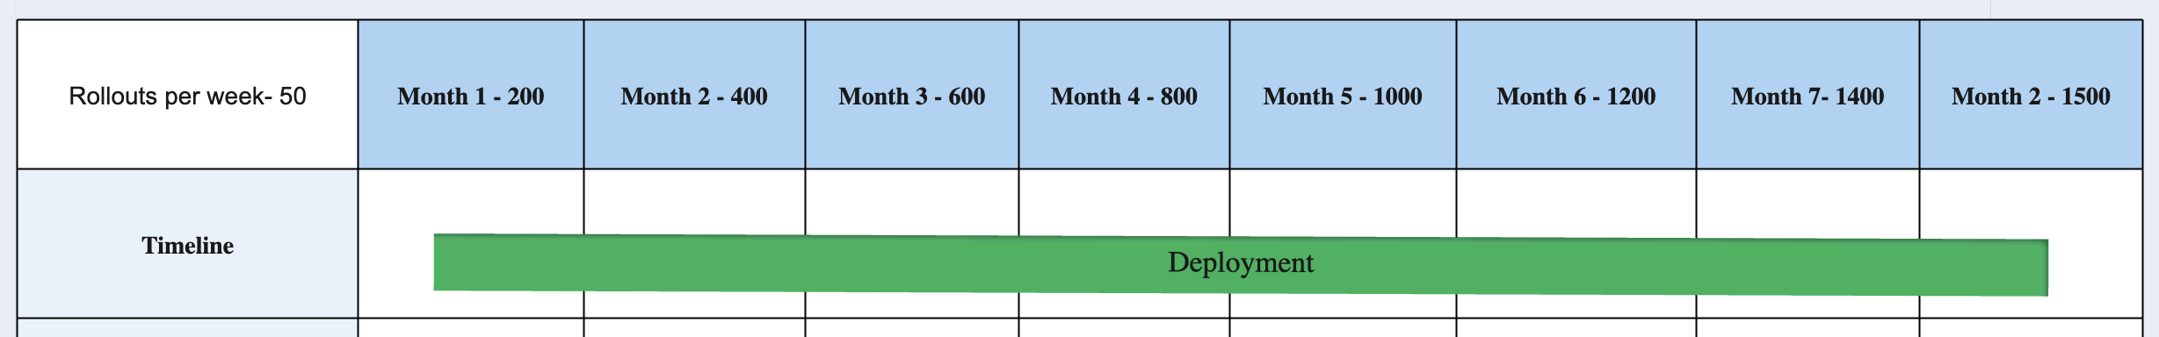
Deployment Plan
Click here for Detailed Rollout Plan

Slide 25
HPCL
Project Status - 🟢 Customer health - 🟢 Hosting – On Prem
Scope & Implementation Date (including Revenue)
VAIA at 200 Type 1 Outlets – Retail [In support]
VAIA at 82 Sites –Type 2 -SOD Locations[In support]
VAIA at 600 Type 1 Outlets – Retail ( Phase 2 ) - 246 are deployed . 354 are yet to be deployed [dependency on the 3party]
Revenue – 4.2m $
ARR-2.8m $
Services – 1.4m $
This week’s Status to Plan
Support tickets & Action
Pending Invoices, Follow up for payments
Appscan results- changes
Issues & Risks
Dependency on the third party[Techsis] for the solution deployment. Therefore actual futher deployment in unknown.
Schedule for Next Week
Support tickets & Score cards
Pending Invoices, Follow up for payments
1. Support tickets & sc

Slide 26
JIOBP NRO
Project Status - 🟢 Customer health - 🟠 Cloud – On Avathon Cloud
Scope & Implementation Date (including Revenue)
Total Number of Sites: 40 Cameras Per Site: 10 Deployed Sites: 30 (10 sites are still pending from JIOBP) Total Use cases : 29 (17 customised, 12 in product) Upcoming Sites: 40 (Expected by 1st week of May, 2025)
Revenue: $100,719.31
ARR - $68,191.54 Services - $32527.77
This week’s Status to Plan
Deploy ingress/egress use case with new models, monitor performance, and implement necessary model adjustments.
Sign Off done from Navada Site in Mumbai. Sanpada site Sign Off is yet to be received.
Issues & Risks
Most sites have poorly positioned camera angles – JIOBP
6 sites have port issues and 5 sites are offline: JIOBP
Camera accessibility issue in 2 sites: JIOBP
Schedule for Next Week
Model Improvement on Decantation, sand bucket, ingress and egress logic review and update from CV.

Slide 27
JIOBP EV
Project Status - 🟢 Customer health - 🟠 Cloud – On Avathon Cloud
Scope & Implementation Date (including Revenue)
Total Number of Sites: 26 Cameras Per Site: 20 Deployed Sites: 5 Total Use cases : 33 (13 developed + 20 in progress) (22 customised, 11 in product) Upcoming Sites: NA
Revenue: $23,626.14
ARR - $16,144.81 Services - $7481.32
This week’s Status to Plan
Monitoring currently deployed​ usecases.
Issues & Risks
JIOBP to provide a dedicated on-site rack for our servers, as it's missing in most of the locations. They've requested a pause in site onboarding until the racks are arranged.
Schedule for Next Week
Data collection and Model improvements.
New Use case Development/Deployment in progress.

Slide 28
JIOBP Cleanliness
Project Status - 🟢 Customer health - 🟠 Hosting – on Prem
Scope & Implementation Date (including Revenue)
Deployment of VAIA at 10 SITES POC Sites
Implementation Date – TBD
Revenue - TBD
This week’s Status to Plan
1.Deployed 10 sites for Mobile upload use cases.
2.Currently the accuracy meets 85%
3. Working to improve accuracy to 95%
Schedule for Next Week
Making changes in report sections as per customer requirement.
Customer to Review the changes implemented on dashboard and get the feedback.
According to the customer, the accuracy needs to meets 95%. Currently at 85%
Proposal sent to customer awaiting for customer to get back to us.
Issues & Risks
NA

Slide 29
JIOBP Warehouse
Project Status - 🟢 Customer health - 🟠 Cloud – On Avathon Cloud
Scope & Implementation Date (including Revenue)
Total Number of Sites: 2 Cameras Per Site: 10 Deployed Sites: 2 Total Use cases : 4 (1 customised, 3 in product) Upcoming Sites: 4
Revenue: $6,874.41
ARR - $4,666.16 Services - $2208.26
This week’s Status to Plan 1. We have made some code changes for the Intrusion Module and have proceeded with the deployment. We are currently working on the Fire Extinguisher Model
Issues & Risks
Schedule for Next Week
Monitoring and improvement of newly deployed model

Slide 30
CP Plus - Reliance (POC)
Project Status - 🟢 Customer health - 🟢 Hosting– On prem
Scope & Implementation Date (including Revenue)
Deployment of VAIA at 5 Reliance POC Sites
Implementation Date Reliance – TBD
Revenue - TBD
Total Usecases – 8
Available in product - 8
This week’s Status to Plan
Validation going on at 5 sites between CPP and Avathon
Avathon visited 5 Reliance stores to support on configuartions and testing – Completed
Schedule for Next Week
Continous monitoring for Accuracy at 5 sites
Handover of 5 sites to customer planned on 30th April from CPP to Reliance
Executive readout planned tentatively – 15th May
Issues & Risks
NA

Slide 31
HUL – CP Plus - POC
Project Status - 🟢 Customer health - 🟢 Hosting– On prem
Scope & Implementation Date (including Revenue)
Scope & Implementation Date (including Revenue)
Deployment of VAIA at 1 HUL POC Site
Implementation Date HUL – TBD
Revenue - TBD
Total Usecases – 6
Custome usecases – 6(Ready to move to product)
This week’s Status to Plan
Waiting on customer to get back
Schedule for Next Week
Schedule for Next Week
Waiting on customer to get back on commercial discussions with CPP
Issues & Risks

Slide 32
MCD – CP Plus - POC
Project Status - 🟢 Customer health - 🟢
Hosting– On Prem
Scope & Implementation Date (including Revenue)
Scope & Implementation Date (including Revenue)
Deployment of VAIA at 2 McD POC Sites
Implementation Date McD – 6th March
Revenue - TBD
Total usecases – 14 Available in product – 8( which required for POC)
This week’s Status to Plan
This week’s Status to Plan
Model optimization for deployed use cases at McD 2 sites
Schedule for Next Week
Pilot Completion – Achieved on 15th April 2025.
o The Heat Map use case will be deployed in the first week of May 2025.
o For Handwash Detection and Garbage Overflow, we are yet to receive video footage, which may delay their inclusion in the upcoming release. Request CP Plus to confirm if any additional support is needed from Avathon on this.
• Executive Readout & Commercial Proposal Discussion – Scheduled for 30th April 2025. CP Plus has shared the commercial proposal, which is currently under review by the McDonald’s team.
• Commercial Closure & PO Allotment – Targeted for 15th May 2025
Issues & Risks

Slide 33
Onitio
Project Status - 🔴 Customer health - 🟠 Cloud -
Scope & Implementation Date (including Revenue)
4 logistics mobile applications for 'Postnord'
In support and continuous development process.
Annual revenue- $562626
This week’s Status to Plan
Working on the release planned on 13th May
Schedule for Next Week
Release on 13th May
Issues & Risks
No issues and risks as of now.

Slide 34
Datema
Project Status - 🔴 Customer health - 🟠 Cloud
Scope & Implementation Date (including Revenue)
We have a product 'Easylogic' created built on Silverline. Easylogic have further customers- Blomsterlandet, Svenska Massan, Sodra, Rovalin, Radvall and Yaskawa.
$170400 annual revenue for services. Hosting cost and licenses are separate. Licenses were $16395, hosting was $23447 in 2024
This week’s Status to Plan
Release a functionality called 'workforce' deployed on UAT. Production planned on Friday
Schedule for Next Week
Work on next release 5.0.0 that has to be in production before 8th of May.
Issues & Risks
Had a P1 issue recently which is now resolved and shared RCA with customer.

Slide 35
UPL
Project Status - 🟢 Customer health - 🟠 Cloud
Scope & Implementation Date (including Revenue)
Total Number of Sites: 4 Cameras Per Site: 20-30 Deployed Sites: 4 Total Use cases : 20 Upcoming Sites: 1.8k cameras
Revenue: TBD
This week’s Status to Plan
New requirement: Manhole opening detection. Currently this usecase is in evalaution and waiting necessary videos/details from client.
Issues & Risks
Schedule for Next Week
Circle back with customer.

Slide 36
Heineken
Project Status - 🔴 Customer health - 🟠 Cloud
Scope & Implementation Date (including Revenue)
We have a FSA deployed in Ireland.
It is in support
$40000 annual
This week’s Status to Plan
No planned work
Schedule for Next Week
No planned work
Issues & Risks
No issues and risks as of now

Slide 37
Xerox
Project Status - 🔴 Customer health - 🟠 Cloud
Scope & Implementation Date (including Revenue)
FSA application, delivered last year, in support now
Revenue- $150000 annually
This week’s Status to Plan
Support ticket for German issue is now closed.
Schedule for Next Week
No planned yet.
Issues & Risks
No issues or risks as of now.

Slide 38
Novo Nordisk
Project Status - 🔴 Customer health - 🟠 Cloud
Scope & Implementation Date (including Revenue)
Implemented and in support
Revenue- $30000 annual
This week’s Status to Plan
Notification issue resolved last week, no plans for this week.
Schedule for Next Week
Not planned yet
Issues & Risks
No issues as of now.

Slide 39
Summary Slide – add in Project & Deployment Start/ends
Slno | Active Implementations | Owner | Product | C Start Date | C End Date | Deployment start date | Deployment end date | Production status | Move to Support
1 | TRL | India | VAIA
2 | CHT | India | VAIA
3 | Nestle | India | VAIA
4 | CP Plus | India | VAIA | 7/19/2024 | 7/18/2028 | POC | POC | POC | POC
5 | Britannia | India | VAIA | 18/10/2024 | 12/31/2025 | 18/02/2024 | TBD | Deployment | Dec 2025
6 | L&T | India | VAIA | 10/15/2024 | 12/31/2025 | 03/01/2025 | 07/31/2025
7 | Woolworth | India | VAIA | POC | POC | POC | POC | POC | POC
8 | HPCL | India | VAIA | 2021 | 2026 | 2021 | 2023 | 2023 | 2023
9 | JIOBP CNG | India | VAIA
10 | JIOBP NRO | India | VAIA
11 | JIOBP Solar | India | VAIA
12 | JIOBP EV | India | VAIA

Slide 40
Summary Slide – add in Project & Deployment Start/ends
Slno | Active Implementations | Owner | Product | C Start Date | C End Date | Deployment start date | Deployment end date | Production status | Move to Support
14 | JIOBP Cleanliness | India | VAIA | POC | POC
15 | JIOBP AFS | India
16 | NXP | India
17 | Qualcomm | India
18 | HUL | India | VAIA | POC – CP Plus
19 | Reliance Digital | India | VAIA | POC – CP Plus
20 | MCD | India | VAIA | POC – CP Plus
21 | Onitio | India
22 | Datema | India

Slide 41
Summary Slide – add in Project & Deployment Start/ends
Slno | Active Implementations | Owner | Product | C Start Date | C End Date | Deployment start date | Deployment end date | Production status | Move to Support
23 | Juniper | India | APM | POC | POC
24 | UPL | India
25 | Heineken | India
26 | Xerox | India
27 | Novo Nordisk | India

Slide 42
Previous Action Items
1. Nestle
Status:
Incorrect NVR timings observed on most cameras.
Malicious activity detected on Nestle servers last week.
Action Taken:
NVR timing issue logged with Nestle for investigation and resolution.
Malicious activity reported to Core9 and Nestle.
Solution was re-deployed on all Nestle servers as a mitigation measure following the malicious activity detection.
Action Required / Status Update:
Awaiting update/resolution from Nestle regarding the NVR timing issue.
Awaiting updates from Core9/Nestle regarding the malicious activity investigation, root cause, and any potential consequences (e.g., planned shutdowns).
Issues/Risks:
NVR Timings: Inaccurate time stamps affect data integrity, event correlation, and usability of recordings.

Slide 43
Previous Action Items
2. JIOBP Solar
Target: All updated solar sites expected to be live by May 5th.
3. TRL
Status (Renewal): Client contact (Anshuman) indicated renewal confirmation is expected by May 15th. * Next Step/Deadline: Renewal confirmation expected from the client by May 15th.
4. L&T
Action Items:
Work on minor dashboard changes requested by L&T customer (In Progress, discussed with Product Team). Target: Include in the next product release.
Follow up with L&T customer for approval/sign-off on the rollout plan. Target: Obtain sign-off next week.
Hold scheduled call with L&T customer to get clarity on the 8 custom use cases. (Simulation videos requested from customer).
Next Week Plan: Expecting details for 40 more cameras and corresponding use case mapping from L&T.
Issues/Risks:
Dependency on Product Team to develop 8 custom use cases.
Dependency on customer for clarity on use cases and providing simulation videos.
Awaiting customer approval on the rollout plan.

Slide 44
Previous Action Items
. HPCL
Status:
TK classifies HPCL as RED due to lack of current revenue generation relative to resource investment.
Phase 1 (Retail): 200 "retail" outlets completed and moved to support. (Hardware was supplied by the Avathon team).
Terminals: 82 sites/locations identified as terminals (large scale, 50-100+ cameras each, 24 use cases). In support
Phase 2 (Retail): Contract for 600 additional retail outlets signed (2024). Team provides solution only; hardware is from a third-party vendor (Texas).
Phase 2 Progress: 246 out of 600 outlets deployed. 354 outlets pending deployment.
Issues/Risks:
Significant delays in Phase 2 retail deployment due to dependency on the third-party hardware vendor (Texas).
High resource burn without corresponding revenue realization currently.
Lack of clarity on specific resource allocation and accountability.
Need breakdown and status of the $1.4M Services revenue associated with the project.

Slide 45
Previous Action Items
Directives from @Thirumalai Krishnan:
Assign one specific owner responsible for the HPCL account updates and management.
Resource Allocation: Previously 17 people assigned (per Zoho). @Dinesh Fatehpuria to plan for 6-7 dedicated resources total going forward.
Only dedicated, assigned personnel (the identified 6-7 people) should log time against HPCL. No "parking time" from unassigned resources. Resource rotation acceptable quarterly if needed.
If hardware delivery from the third-party vendor is delayed, resources assigned to the remaining 354 retail deployments should be reassigned to billable projects during the waiting period.
Emphasized the need for all Services hours to be billable/justified against revenue-generating activities – requires a culture change.

Slide 46
Previous Action Items
Action Items (for Next Review):
[HPCL Owner - TBD]: Identify the single point of contact/owner for the HPCL account.
Dinesh: Confirm and identify the specific 6-7 dedicated resources for HPCL (terminals & retail).
Damini: Provide an update on:
How the 200 completed Phase 1 retail outlets are currently supported. Number of people required for this support. Who is leading this support effort?
Damini: Provide an update on:
How the 82 Terminals are currently supported. Number of people required for this support.
[HPCL Owner]: Determine the timeline/plan for moving the 246 deployed Phase 2 retail outlets into support.
[HPCL Owner]: Obtain contact information for the third-party hardware vendor (Techsis).
[HPCL Owner]: Schedule a call with the third-party vendor (Techsis), involving HPCL if appropriate, to get a confirmed delivery timeline for hardware for the remaining 354 retail outlets.
[HPCL Owner]: Based on the hardware delivery timeline, develop a week-by-week deployment plan (tasks, hours) for the remaining 354 retail outlets.
TK & Dinesh: Discuss and obtain a detailed breakdown of the $1.4M Services revenue: How is it earned? What's the payment schedule? Does it cover terminals/retail? How much consumed vs. remaining? (Target: Discuss next week as Dinesh is travelling).

Slide 47
Previous Action Items
. General / Other Projects
Action Item (TK): Detailed review of HPCL and Reliance planned for the next project review call.
Action Item (All Project Owners): For all projects with services revenue: provide a week-wise plan, resource allocation, and revenue breakdown (similar to HPCL request). Understand which POCs are no-charge (e.g., CP Plus, McDonald's, Reliance).
Action Item (All Project Owners): Ensure accurate time tracking against specific projects or general non-billable codes. Non-billable time indicates a need for TK to find billable assignments.
Next Steps:
Focus the next project review meeting on a detailed discussion of HPCL and Reliance as per TK's request.
Relevant owners to prepare the requested information and action item updates for the next meeting.

